Slide 1
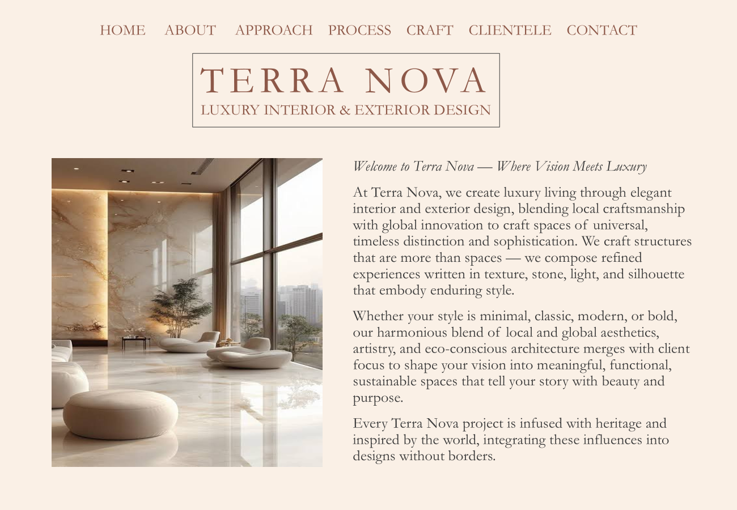
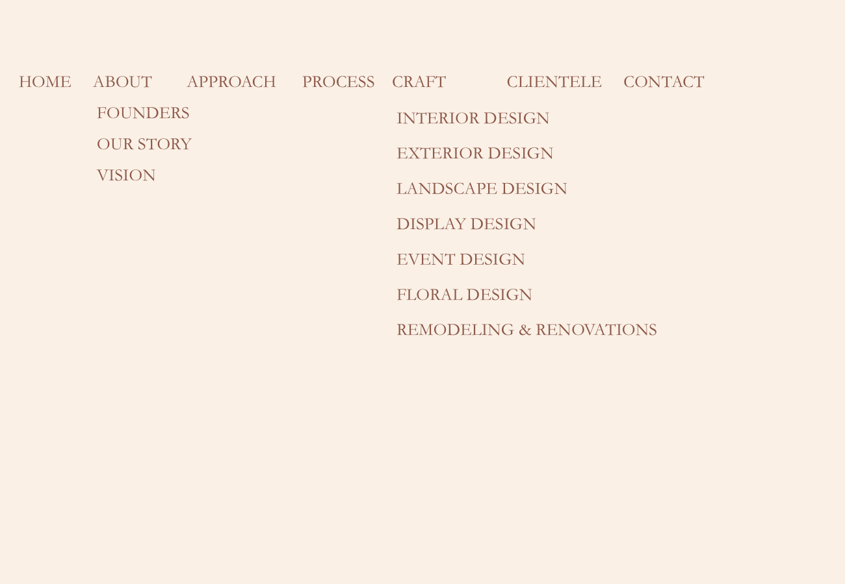
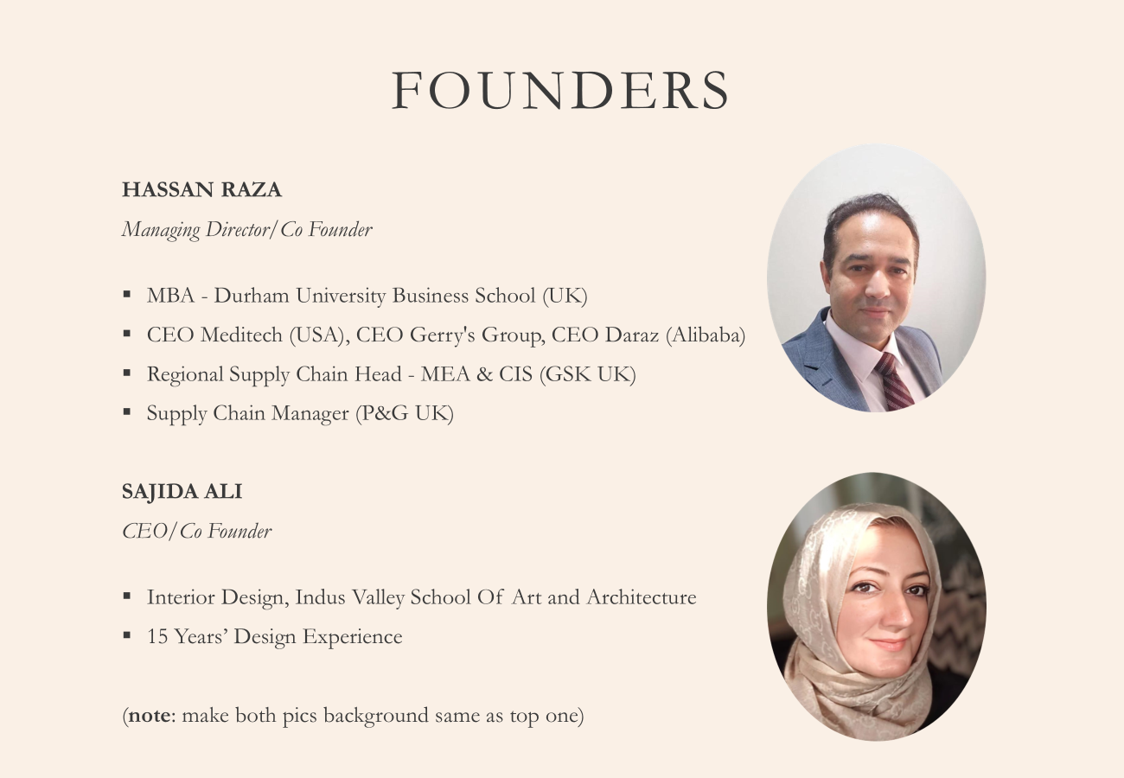
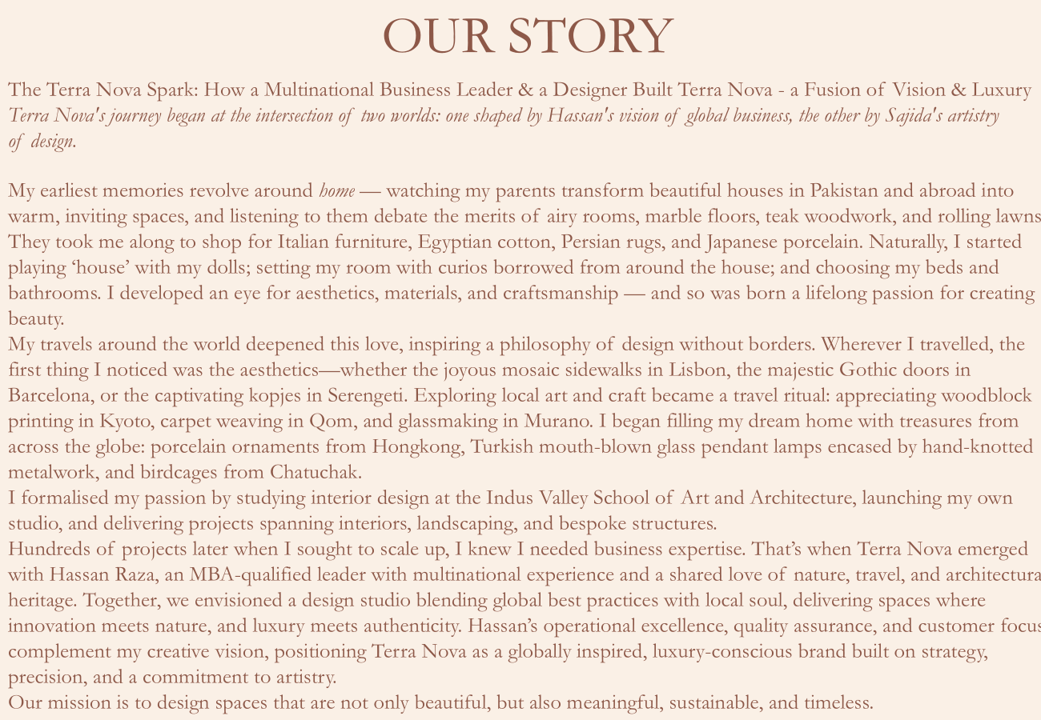
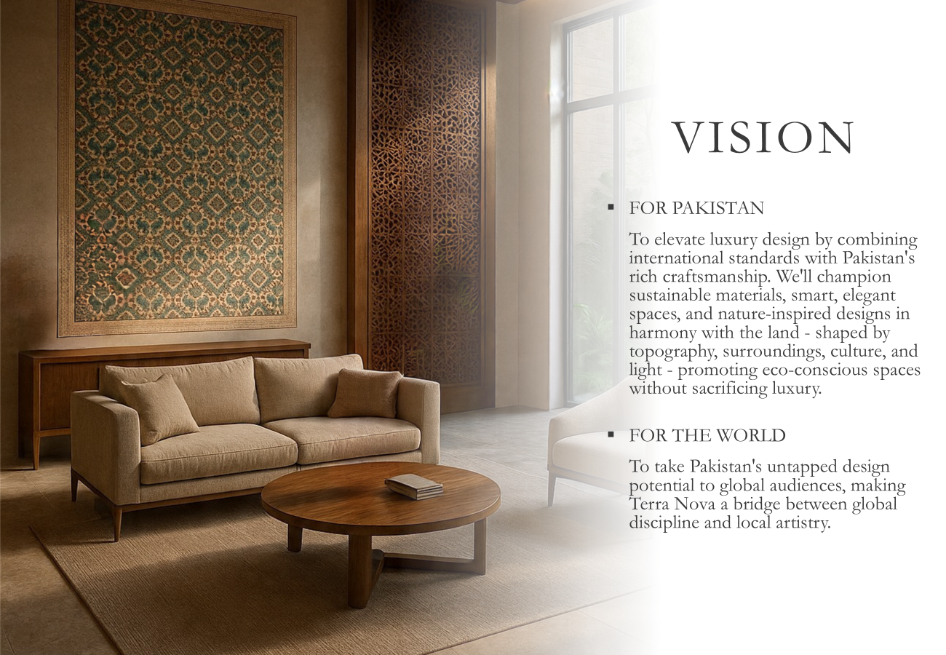
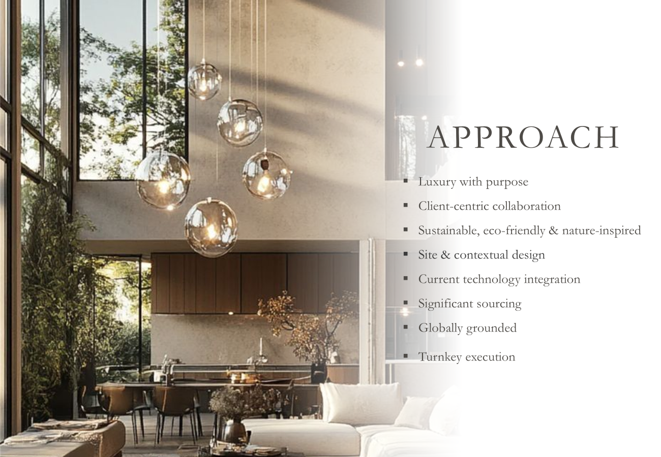

Slide 2
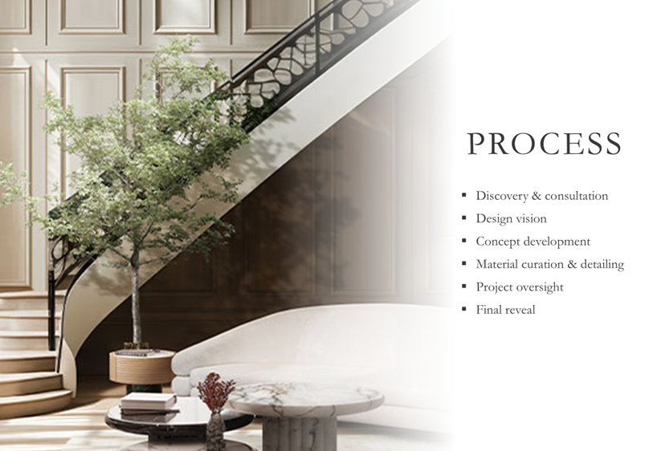
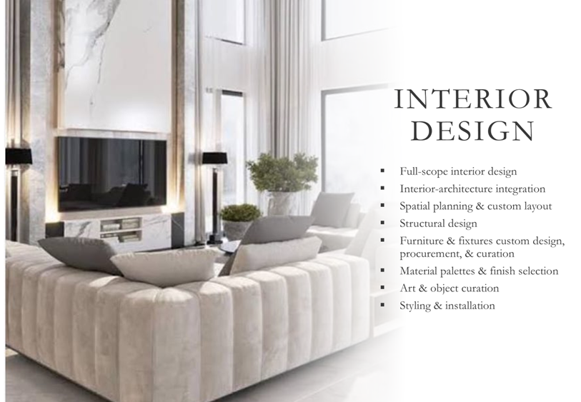
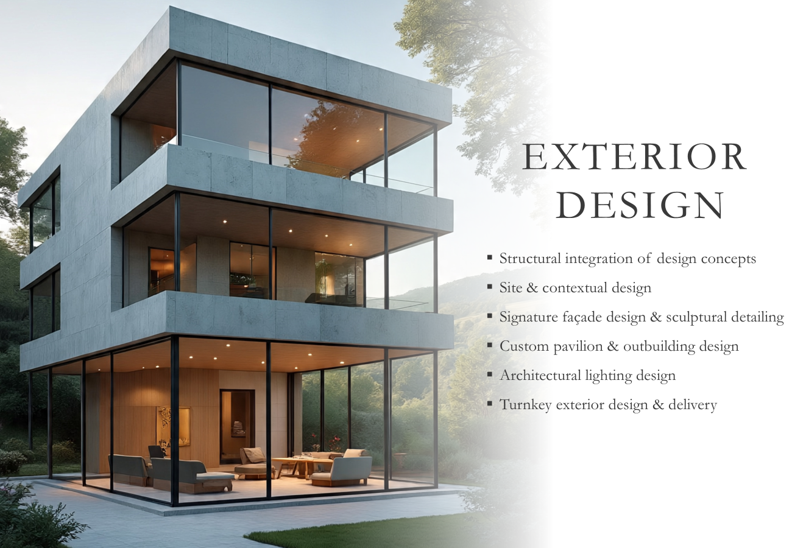
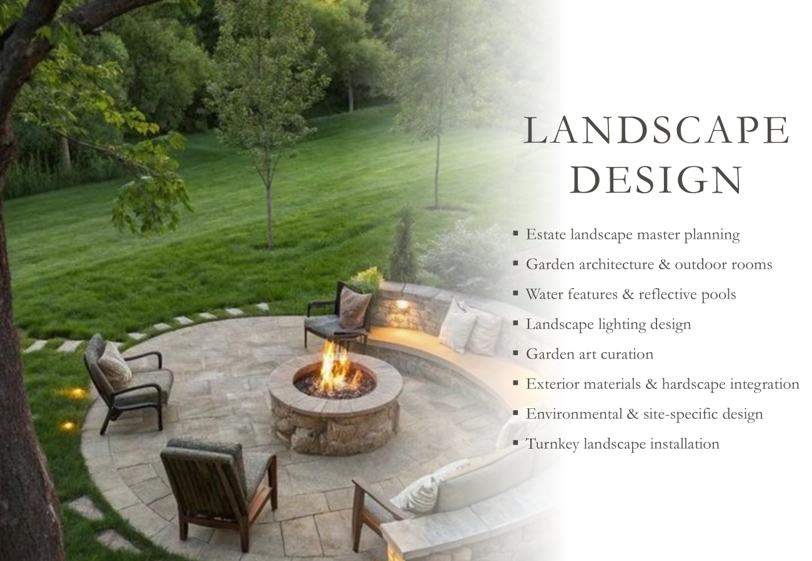
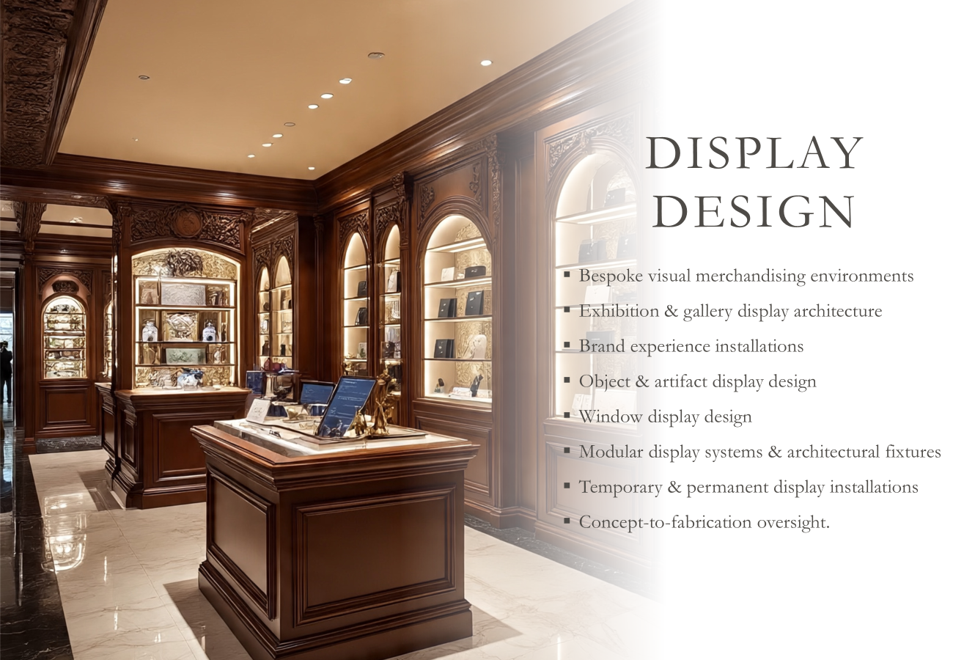
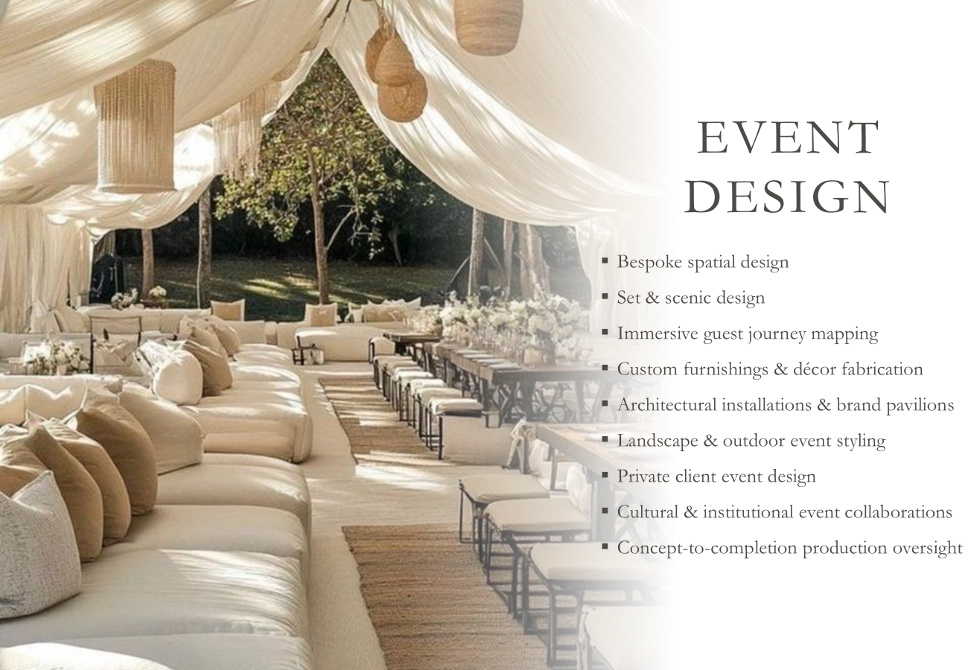

Slide 3
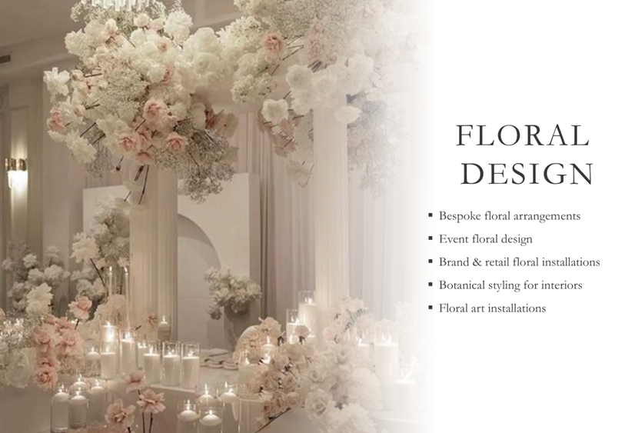
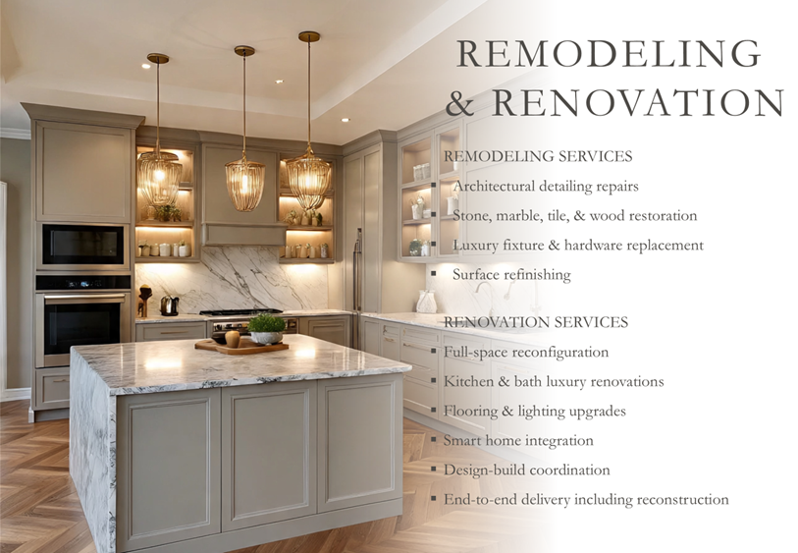
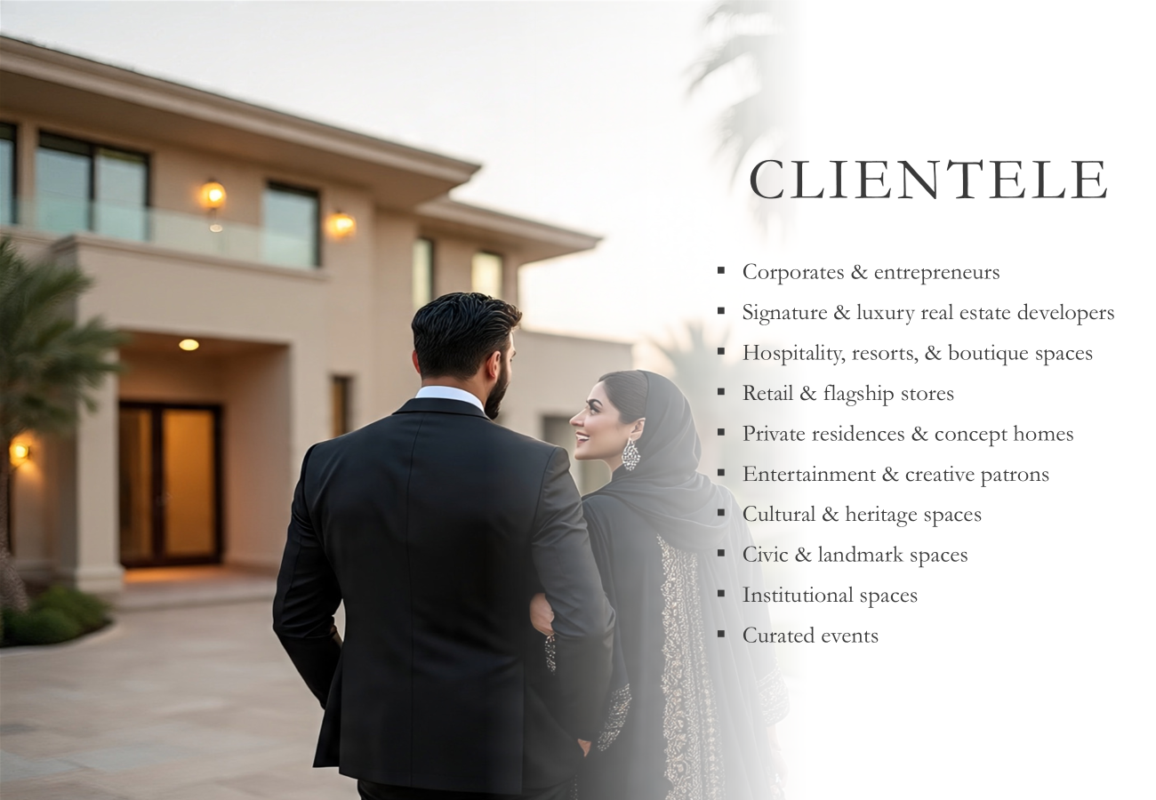


Slide 4
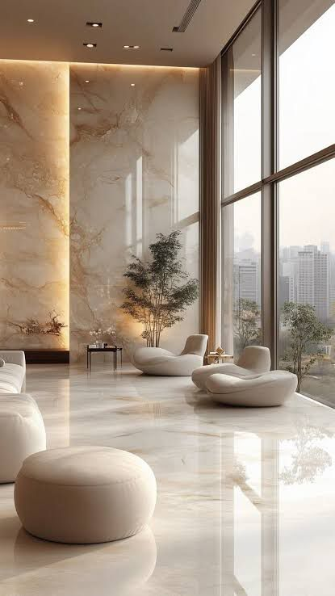
TERRA NOVA LUXURY INTERIOR & EXTERIOR DESIGN
HOME ABOUT APPROACH PROCESS CRAFT CLIENTELE CONTACT
Welcome to Terra Nova — Where Vision Meets Luxury
At Terra Nova, we create luxury living through elegant interior and exterior design, blending local craftsmanship with global innovation to craft spaces of universal, timeless distinction and sophistication. We craft structures that are more than spaces — we compose refined experiences written in texture, stone, light, and silhouette that embody enduring style.
Whether your style is minimal, classic, modern, or bold, our harmonious blend of local and global aesthetics, artistry, and eco-conscious architecture merges with client focus to shape your vision into meaningful, functional, sustainable spaces that tell your story with beauty and purpose.
Every Terra Nova project is infused with heritage and inspired by the world, integrating these influences into designs without borders.

Slide 5
HOME ABOUT APPROACH PROCESS CRAFT CLIENTELE CONTACT
FOUNDERS
OUR STORY
VISION
INTERIOR DESIGN
EXTERIOR DESIGN
LANDSCAPE DESIGN
DISPLAY DESIGN
EVENT DESIGN
FLORAL DESIGN
REMODELING & RENOVATIONS

Slide 6


Founders
HASSAN RAZA
Managing Director/Co Founder
MBA - Durham University Business School (UK)
CEO Meditech (USA), CEO Gerry's Group, CEO Daraz (Alibaba)
Regional Supply Chain Head - MEA & CIS (GSK UK)
Supply Chain Manager (P&G UK)
SAJIDA ALI
CEO/Co Founder
Interior Design, Indus Valley School Of Art and Architecture
15 Years’ Design Experience
(note: make both pics’ background same as top one)

Slide 7
OUR STORY
The Terra Nova Spark: How a Multinational Business Leader & a Designer Built Terra Nova - a Fusion of Vision & Luxury
Terra Nova's journey began at the intersection of two worlds: one shaped by Hassan's vision of global business, the other by Sajida's artistry
of design.
My earliest memories revolve around home — watching my parents transform beautiful houses in Pakistan and abroad into warm, inviting spaces, and listening to them debate the merits of airy rooms, marble floors, teak woodwork, and rolling lawns. They took me along to shop for Italian furniture, Egyptian cotton, Persian rugs, and Japanese porcelain. Naturally, I started playing ‘house’ with my dolls; setting my room with curios borrowed from around the house; and choosing my beds and bathrooms. I developed an eye for aesthetics, materials, and craftsmanship — and so was born a lifelong passion for creating beauty.
My travels around the world deepened this love, inspiring a philosophy of design without borders. Wherever I travelled, the first thing I noticed was the aesthetics—whether the joyous mosaic sidewalks in Lisbon, the majestic Gothic doors in Barcelona, or the captivating kopjes in Serengeti. Exploring local art and craft became a travel ritual: appreciating woodblock printing in Kyoto, carpet weaving in Qom, and glassmaking in Murano. I began filling my dream home with treasures from across the globe: porcelain ornaments from Hongkong, Turkish mouth-blown glass pendant lamps encased by hand-knotted metalwork, and birdcages from Chatuchak.
I formalised my passion by studying interior design at the Indus Valley School of Art and Architecture, launching my own studio, and delivering projects spanning interiors, landscaping, and bespoke structures.
Hundreds of projects later when I sought to scale up, I knew I needed business expertise. That’s when Terra Nova emerged with Hassan Raza, an MBA-qualified leader with multinational experience and a shared love of nature, travel, and architectural heritage. Together, we envisioned a design studio blending global best practices with local soul, delivering spaces where innovation meets nature, and luxury meets authenticity. Hassan’s operational excellence, quality assurance, and customer focus complement my creative vision, positioning Terra Nova as a globally inspired, luxury-conscious brand built on strategy, precision, and a commitment to artistry.
Our mission is to design spaces that are not only beautiful, but also meaningful, sustainable, and timeless.

Slide 8
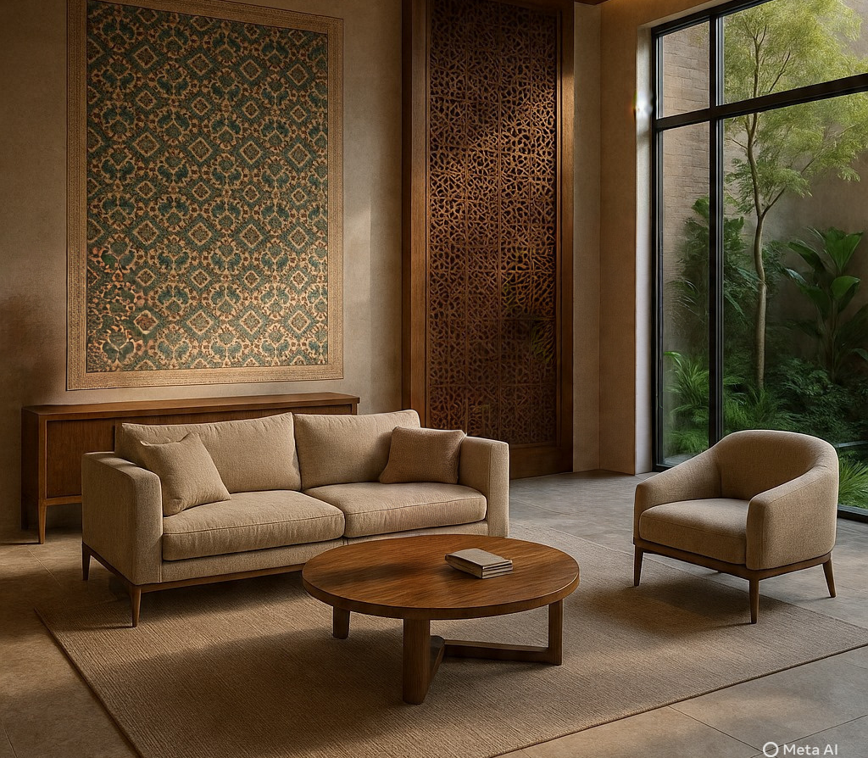
VISION
FOR PAKISTAN
To elevate luxury design by combining international standards with Pakistan's rich craftsmanship. We'll champion sustainable materials, smart, elegant spaces, and nature-inspired designs in harmony with the land - shaped by topography, surroundings, culture, and light - promoting eco-conscious spaces without sacrificing luxury.
FOR THE WORLD
To take Pakistan's untapped design potential to global audiences, making Terra Nova a bridge between global discipline and local artistry.

Slide 9
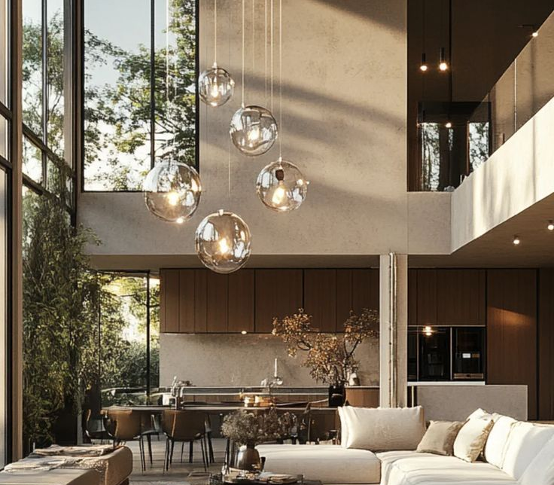
Approach
Luxury with purpose
Client-centric collaboration
Sustainable, eco-friendly & nature-inspired
Site & contextual design
Current technology integration
Significant sourcing
Globally grounded
Turnkey execution

Slide 10
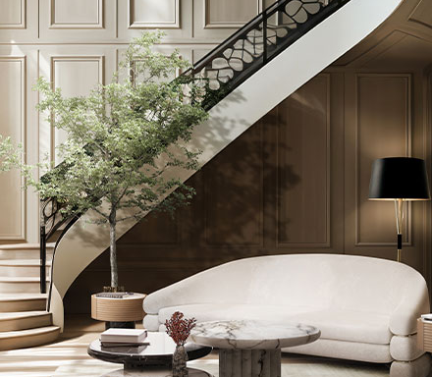
Process
Discovery & consultation
Design vision
Concept development
Material curation & detailing
Project oversight
Final reveal

Slide 11
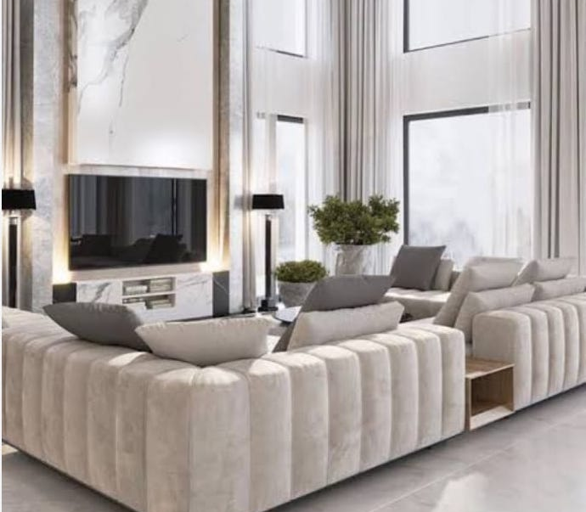
Interior Design
Full-scope interior design
Interior-architecture integration
Spatial planning & custom layout
Structural design
Furniture & fixtures custom design, procurement, & curation
Material palettes & finish selection
Art & object curation
Styling & installation

Slide 12
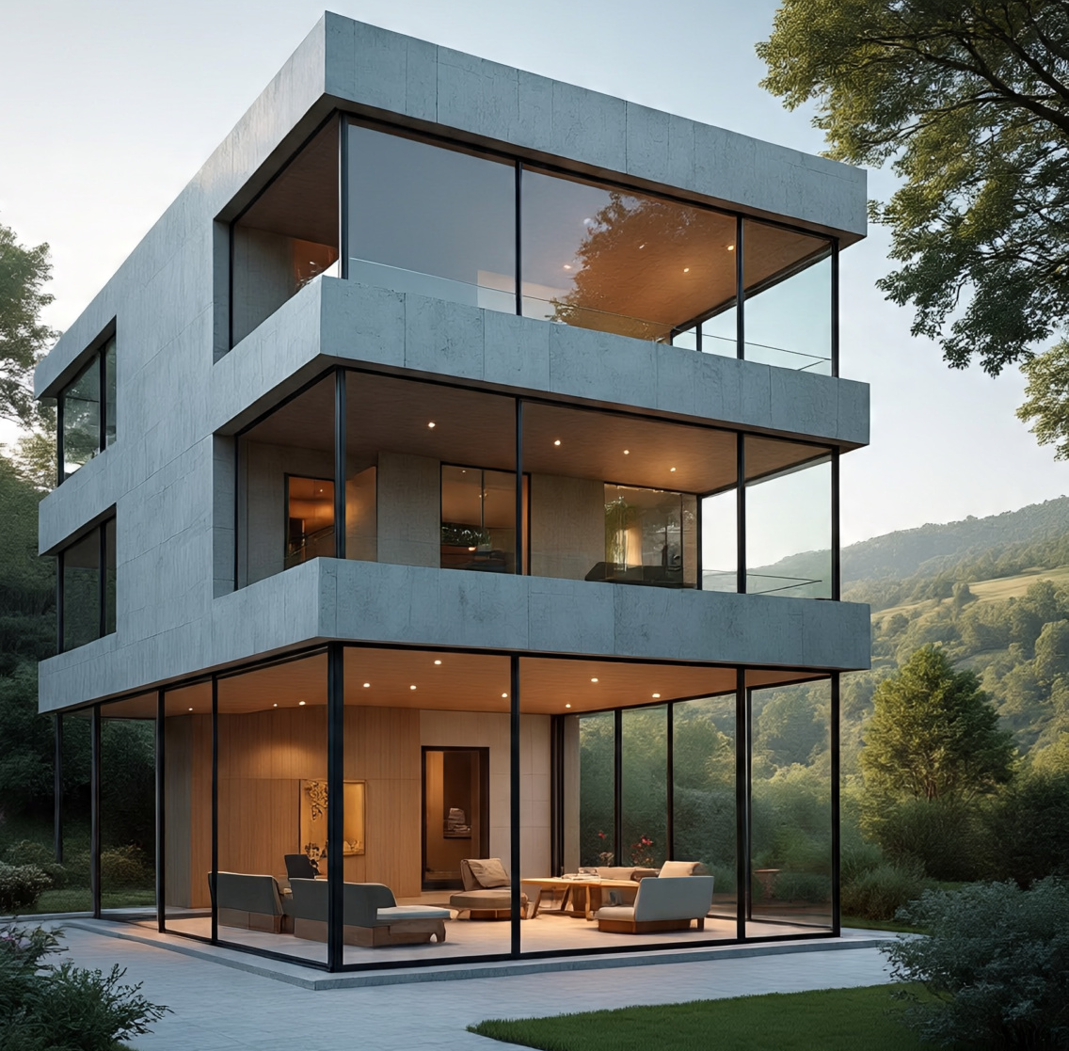
Exterior
Design
Structural integration of design concepts
Site & contextual design
Signature façade design & sculptural detailing
Custom pavilion & outbuilding design
Architectural lighting design
Turnkey exterior design & delivery

Slide 13
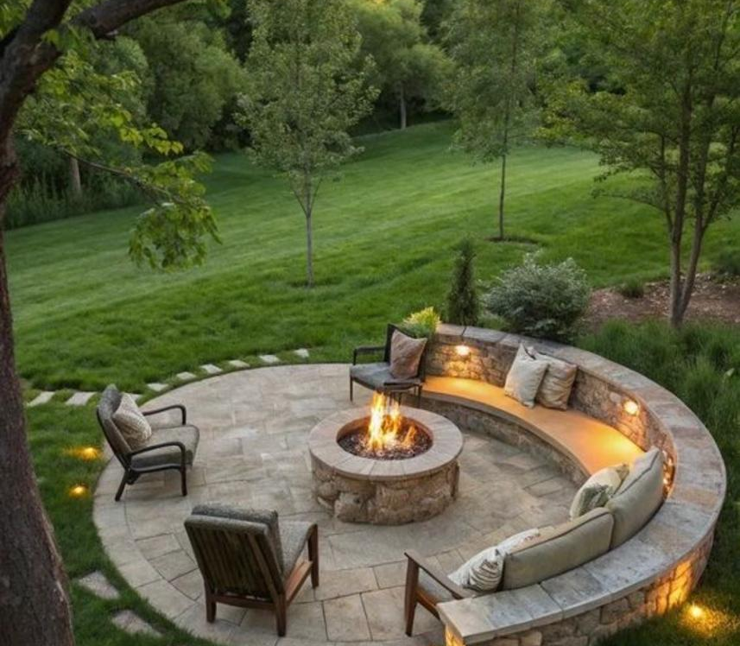
Landscape Design
Estate landscape master planning
Garden architecture & outdoor rooms
Water features & reflective pools
Landscape lighting design
Garden art curation
Exterior materials & hardscape integration
Environmental & site-specific design
Turnkey landscape installation

Slide 14
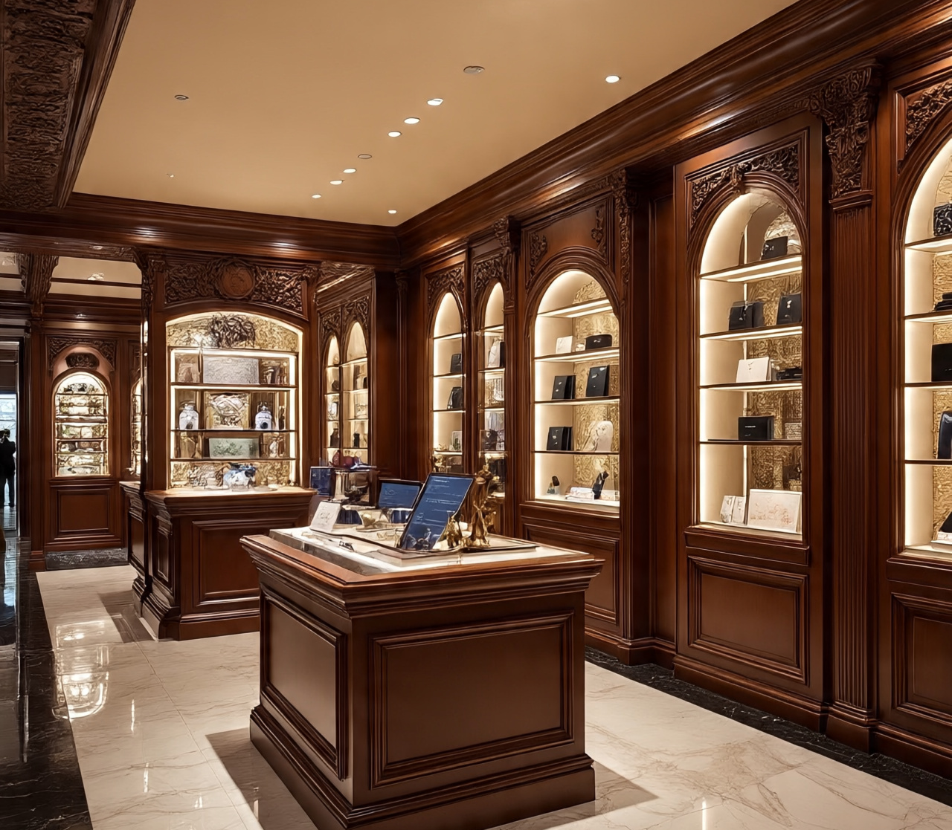
Display Design
Bespoke visual merchandising environments
Exhibition & gallery display architecture
Brand experience installations
Object & artifact display design
Window display design
Modular display systems & architectural fixtures
Temporary & permanent display installations
Concept-to-fabrication oversight.

Slide 15
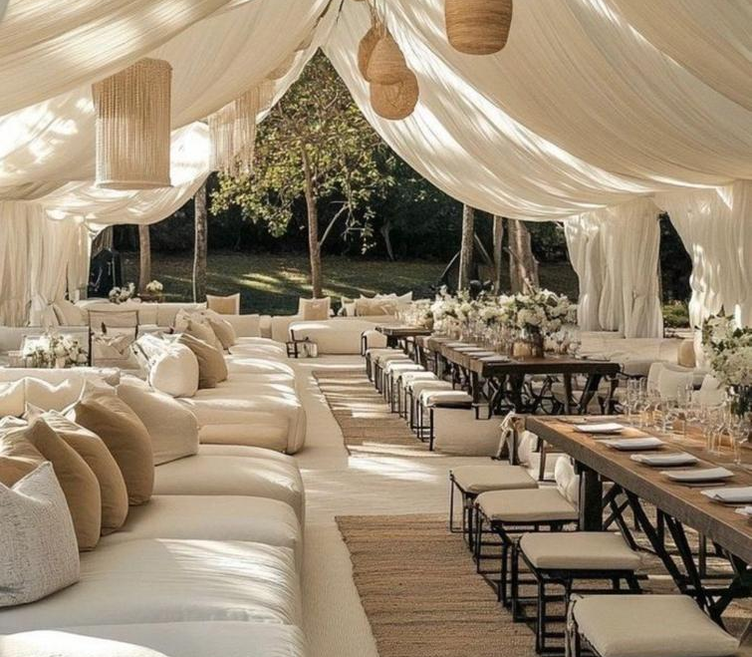
Event Design
Bespoke spatial design
Set & scenic design
Immersive guest journey mapping
Custom furnishings & décor fabrication
Architectural installations & brand pavilions
Landscape & outdoor event styling
Private client event design
Cultural & institutional event collaborations
Concept-to-completion production oversight

Slide 16
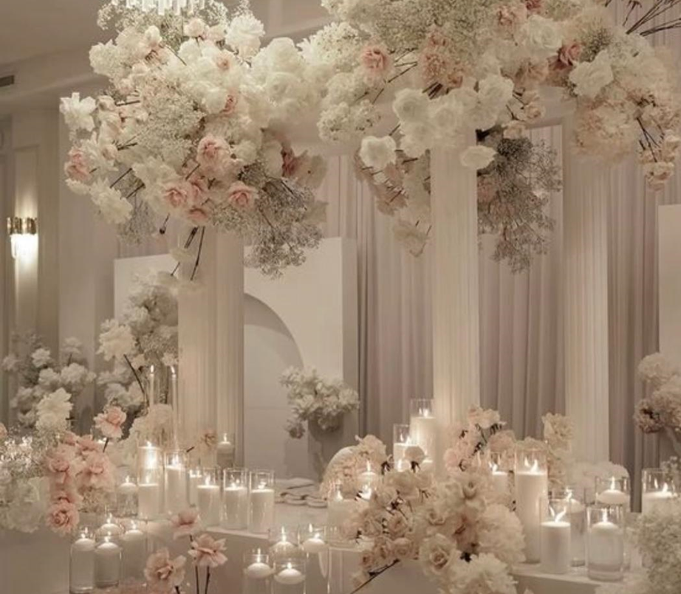
FLORAL
DESIGN
Bespoke floral arrangements
Event floral design
Brand & retail floral installations
Botanical styling for interiors
Floral art installations

Slide 17
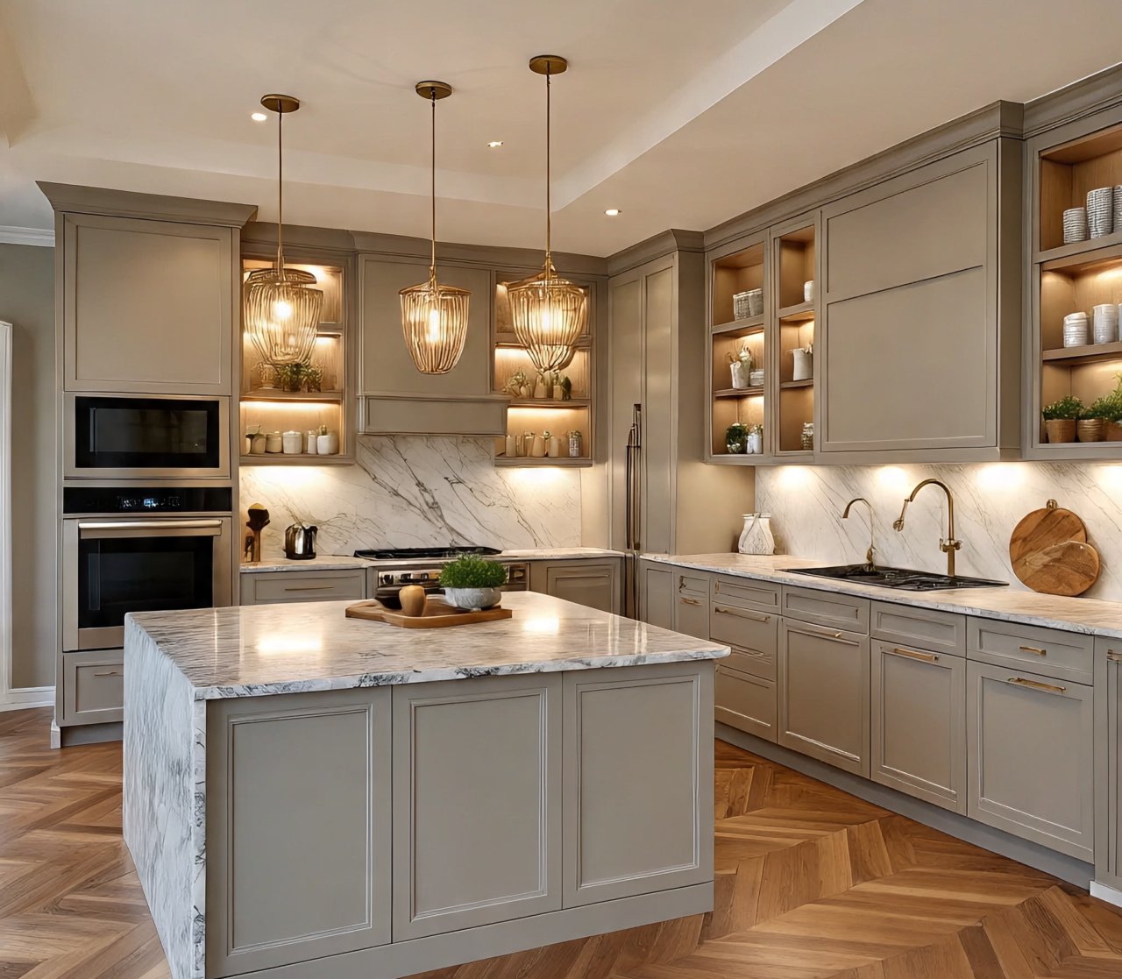
Remodeling
& Renovation
REMODELING SERVICES
Architectural detailing repairs
Stone, marble, tile, & wood restoration
Luxury fixture & hardware replacement
Surface refinishing
RENOVATION SERVICES
Full-space reconfiguration
Kitchen & bath luxury renovations
Flooring & lighting upgrades
Smart home integration
Design-build coordination
End-to-end delivery including reconstruction

Slide 18
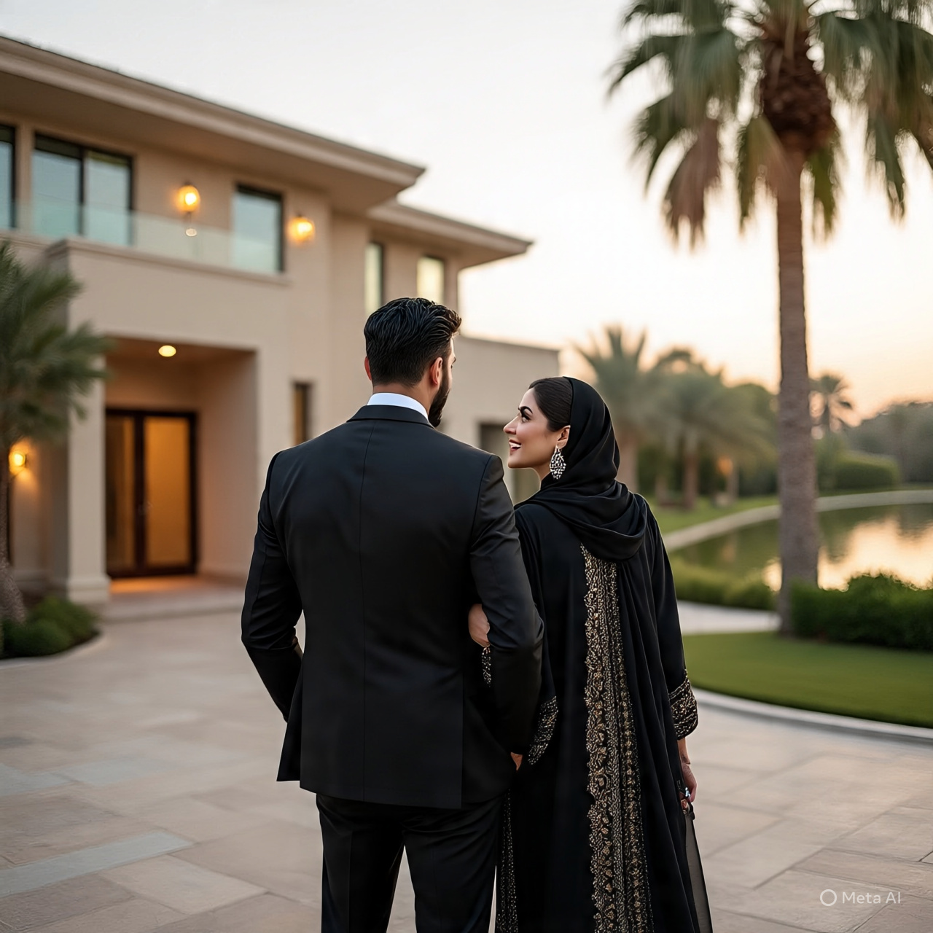
CLIENTELE
Corporates & entrepreneurs
Signature & luxury real estate developers
Hospitality, resorts, & boutique spaces
Retail & flagship stores
Private residences & concept homes
Entertainment & creative patrons
Cultural & heritage spaces
Civic & landmark spaces
Institutional spaces
Curated events

Slide 19
CONTACT
Name:
Email:
Phone:
Query:
(Terra Nova)WhatsApp
(Terra Nova)Email:

